Slide 1
Handwriting practice
This presentation will:
Give some examples of handwriting practice activities

Slide 2
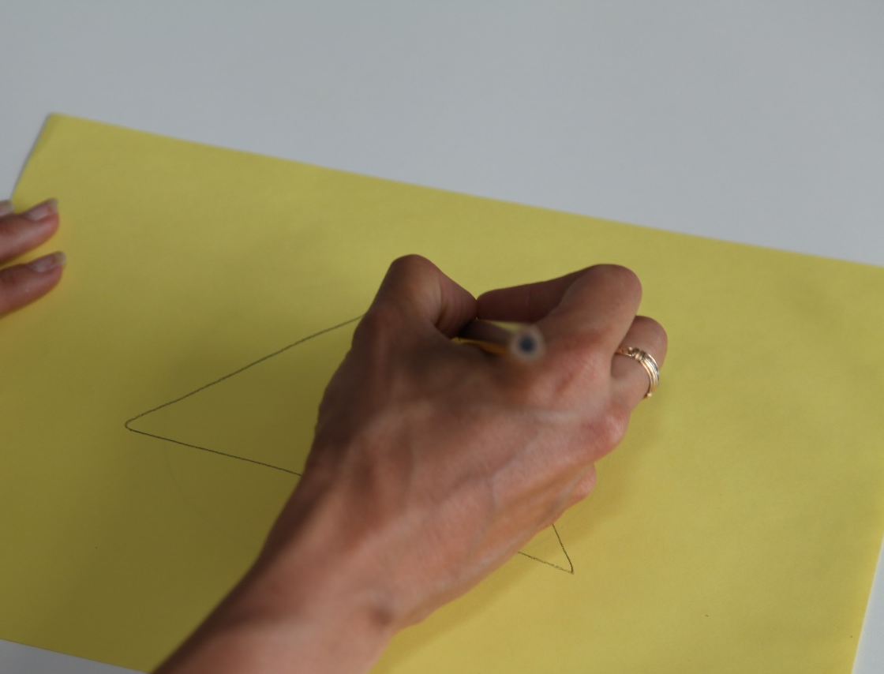
Handwriting Practice Activities
Practice prewriting shapes - the ability to produce prewriting shapes is a prerequisite to the ability to combine those shapes to form letters and pictures
Practice up – down, over – under and diagonal movements large then small - practicing large to small enables learning the movement and then refining it.

Slide 3
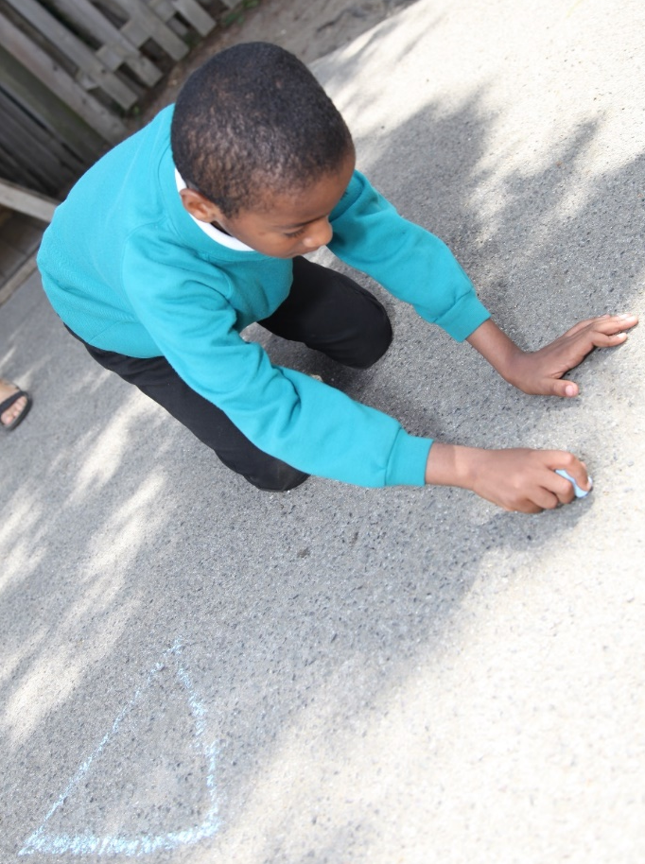
Handwriting Practice Activities
In addition:
Group similar letters – for example: a,g,q,c,d or l, I t, h .
This will simplify the movements required to practice the letters and generalise the movements across a series of letters

Slide 4
Handwriting Practice Activities
4. Use a multi-sensory approach
Use chalk, sand, glitter, paint etc. to produce pre writing shapes progressing to letters. This increases sensory feedback as well as practicing the movement.
Using items such as plasticine, cardboard or lego to create and make letters or words, really helps learners integrate their writing
www.multisensorylearning.lgfl.net ©2018 www.hirstwood.com & London Grid for Learning

Slide 5
Handwriting Practice Activities
Draw shapes on the child’s back and get them to guess what they are – this provides and understanding of the feel of letters and aids recall
Air writing (writing letters or words in the air) as you imagine and say them can also help.

Slide 6
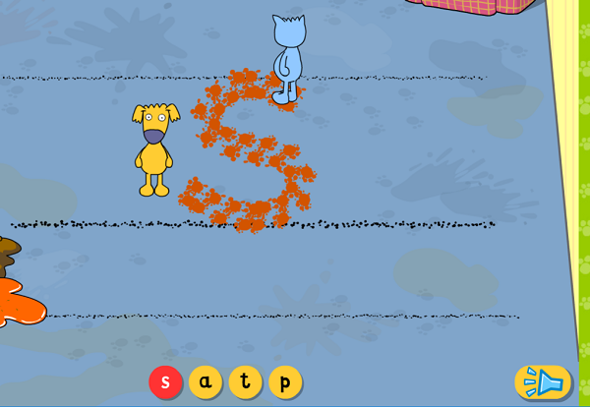
Letter and Word Writing
The messy letters and associated tools within LGfL’s Busy Things (www.busythings.lgfl.net) can support learners in a similar way when using tablets, phones, whiteboards or computers.
www.multisensorylearning.lgfl.net ©2018 www.hirstwood.com & London Grid for Learning

Slide 7
Handwriting Practice Activities
6. Promote handwriting programmes if handwriting becomes an issue beyond Y1 – there are many commercially available to choose from.

